Slide 1
Reusable Shock Absorber for New Lunar Lander
Virtual Design Review 1
Team 515
10/22/20

Slide 2
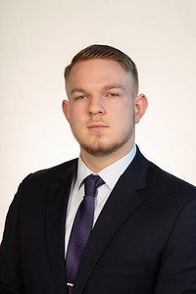
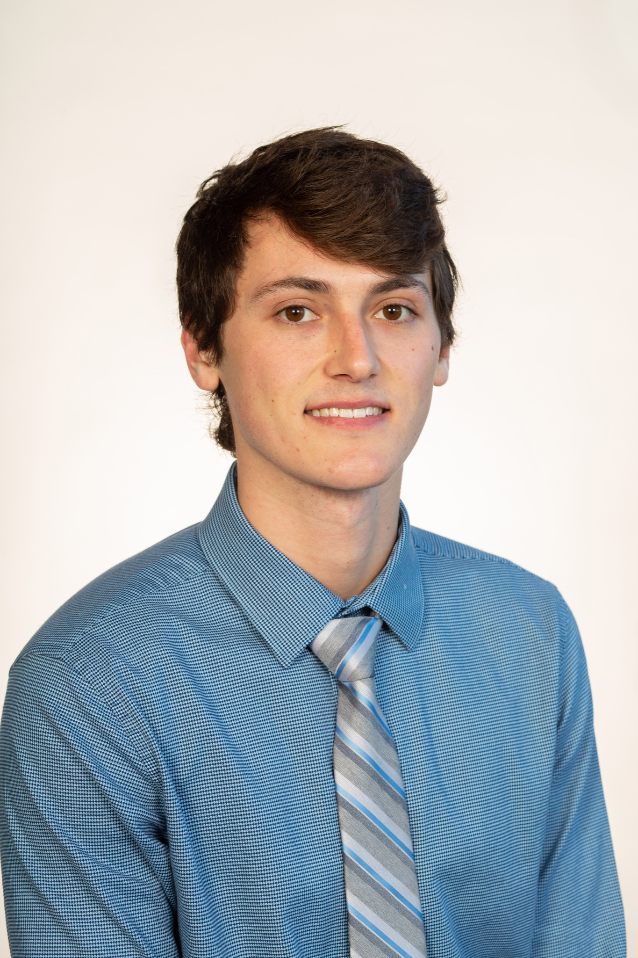
Team Members
Team Members
Josh Blank
Design Engineer
Matt Fowler
Systems Engineer
Tristan Jenkins
Design Engineer
Alex Noll
Mechanical Engineer
Melanie Porter
Dynamics Engineer
T515: Alex Noll

Slide 3
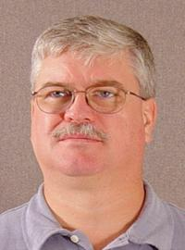
Sponsor & Advisor
Sponsor & Advisor
Project Sponsor
Rachel McCauley
MSFC Advanced Concepts Deputy Manager at NASA
Academic Advisor
Keith Larson
Teaching Faculty I

Slide 4
Objective
To design a reusable device for the human lander system that will dissipate the impact energy in such a way that it does not damage the vessel or occupants.

Slide 5
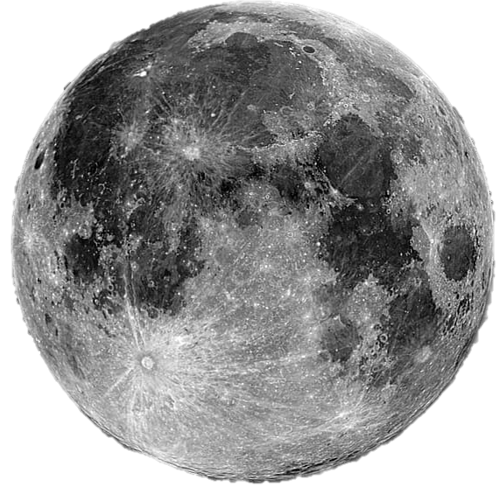
Project Description
Mission: Artemis
Reusable device
2024
1st

Slide 6
Key Goals
Key Goals
Safety
Lightweight
Reusable
Astronaut David R. Scott, commander, gives a military salute while standing beside the deployed United States flag during the Apollo 15 mission.

Slide 7
Markets
Markets

Slide 8
Assumptions
Angle
Vacuum
Attachment Points
Assumptions
Mass
Link
Landing Speed
Operating Temperature

Slide 9
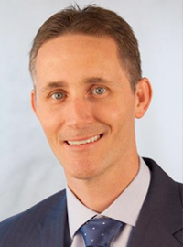
Stakeholders
Stakeholders

Slide 10
Customer Needs
Customer Needs
The product can support 25,000 kg under earth's gravity and the moon's gravity.
A lightweight device.
The product can land at up to a 10-degree offset from the z-axis.
Little to no maintenance.
The product is reusable in space.
Product can repeatedly withstand a maximum impact velocity of 10ft/s.
Link

Slide 11
Functions
Functions
Shock Absorber
Support
Impact Reduction
Reusability
Absorb Shock
Support Mass
Absorb Impact Energy
Returns to original state
Dampen Vibrations
Transform Energy
Indicate Reusability
Link
Prevent Excessive Rebound
Dissipate Energy
Store Energy

Slide 12
Thank You
View of Apollo 14 Lunar Module on the Moon

Slide 13
Backup Slides

Slide 14
Back Up Assumptions
The maximum landing angle is assumed to be 10 degrees.
It is assumed that the device will only operate in the vacuum of space.
It is assumed that the attachment points for the legs will be provided by the sponsor.
It is assumed that the lunar lander module will have four legs.
It is assumed that the mass of the lunar lander will 25 metric tonnes.
It is assumed that the maximum landing speed will be 3.048 m/s (10ft/s).
It is assumed that the device will be subjected a temperature range of -280F to 280F.

Slide 15
Back Up Customer Needs 1
Question | Customer Response | Interpreted Need
How many uses will be considered reusable? | As many as possible. | 1) The product can be used indefinitely.
What are aspects of the current product that are positive? | The Apollo struts were lightweight. | 2) The product is lightweight.
What are aspects of the current product that are negative? | They could only be used once and were left behind on the moon. | 3) The product can be sent to the moon and used repeatedly.
Will the project return to Earth? | No. | 4) The product will not return to Earth in between trips.
How often should maintenance be performed on the product? | Not at all | 5) No routine maintenance is necessary.
What does the project brief mean when it says “hop”? | Module will transition between sites on the lunar surface. | 6) Shock absorber dynamic qualities does not change or diminish after an impact.

Slide 16
Back Up Customer Needs 2
Question | Customer Response | Interpreted Need
Why are shock absorbers needed? | To reduce the impact velocity of the lander to a comfortable level. | 7) Shock absorbers are needed to safely slow the lunar lander impact.
What tools will be needed for maintenance? | As few tools (light weight) as possible. | 8) Multiple components can be fixed by the same tool.
What is the maximum landing speed of the lunar lander? | 10 feet per second. | 9) The product can handle an impact speed of 10 feet per second.
How many legs are on the module? | 4 legs. | 10) Each of the four legs will have a shock absorber component.
How massive is the lunar module? | About twice as much as the Apollo lander. | 11) The product can support 32,800 kg.
Will the legs need to be load bearing on the Earth? | No. | 12) The legs are only required to bear load under lunar gravity.

Slide 17
Back Up Functional Decomp
Functional Decomposition Cross Reference Table. Rows more important than columns
 | Withstand Shock | Support Weight | Absorb Impact Energy | Dampen Vibrations | Prevent Excessive Rebound | Transform Energy | Dissipate Energy | Store Energy | Return to Origingal State | Sum
Withstand Shock | - | 1 | 0 | 1 | 1 | 1 | 1 | 1 | 1 | 7
Support Weight | 0 | - | 0 | 1 | 1 | 1 | 1 | 1 | 1 | 6
Absorb Impact Energy | 1 | 1 | - | 1 | 1 | 1 | 1 | 1 | 1 | 8
Dampen Vibrations | 0 | 0 | 0 | - | 0 | 0 | 1 | 1 | 0 | 2
Prevent Excessive Rebound | 0 | 0 | 0 | 1 | - | 1 | 1 | 1 | 0 | 4
Transform Energy | 0 | 0 | 0 | 1 | 0 | - | 1 | 1 | 0 | 3
Dissipate Energy | 0 | 0 | 0 | 0 | 0 | 0 | - | 1 | 0 | 1
Store Energy | 0 | 0 | 0 | 0 | 0 | 0 | 0 | - | 0 | 0
Return to Origingal State | 0 | 0 | 0 | 1 | 1 | 1 | 1 | 1 | - | 5
Rank | 2 | 3 | 1 | 7 | 5 | 6 | 8 | 9 | 4
Rank | Function
1 | Absorb Impact Energy
2 | Withstand Shock
3 | Support Weight
4 | Return to Original State
5 | Prevent Excessive Rebound
6 | Transform Energy
7 | Dampen Vibrations
8 | Dissipate Energy
9 | Store Energy

Slide 18
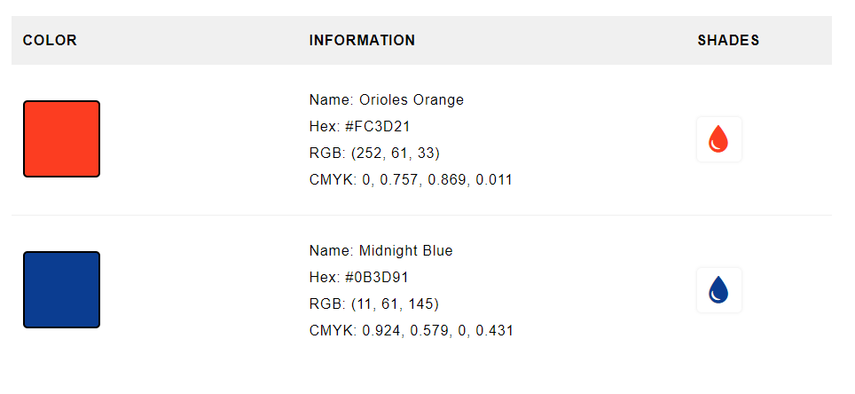
NASA Colors

